Slide 1
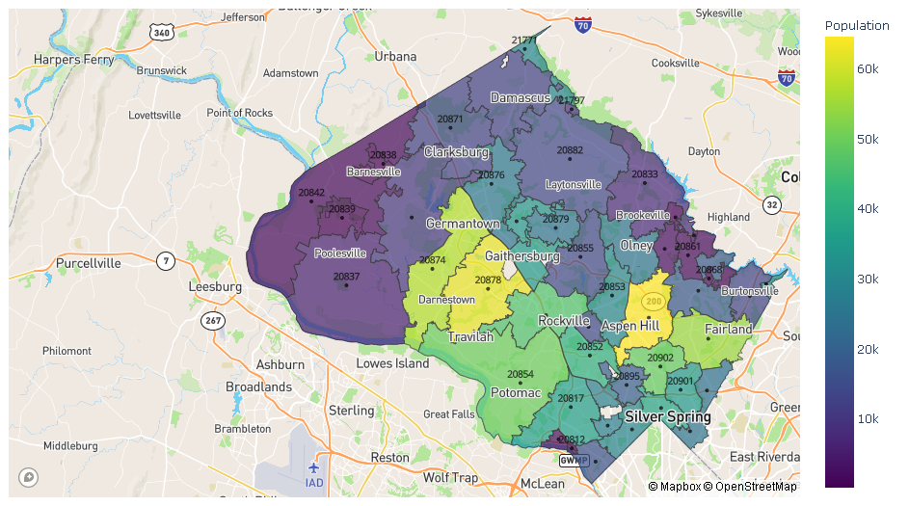
On Montgomery County Population and Crime Interactive Visualizations Using Dash
Daeshik Park

Slide 2
Information of Datasets
Data | Source | Description
MC Zip Codes GIS | MC GIS Open Data | Provide Zip codes and their boundaries on a Montgomery County map
ZIP Code Tabulation Areas (ZCTAs) | Maryland Census Data | Provide general demographic characteristics such as age, race, ethnicity, household relationship, housing vacancy and tenure
Real Property Tax | dataMontgomery | Updated annually in July and represent all of the County’s residential real estate properties and all of the associated tax charges and credits
Crime | dataMontgomery | Include all founded crimes reported after July 1, 2016, and is refreshed on a quarterly basis to reflect any changes

Slide 3
Objectives of Project
Relationships between County’s Property Tax and Race
Does the number of yearly victims follow the same pattern as the total number of victims over zip codes?
Any pattern on the normalized number of victims over zip codes
Main objective: Interactive visualizations on MC Population and Crime Victims using Dash

Slide 4
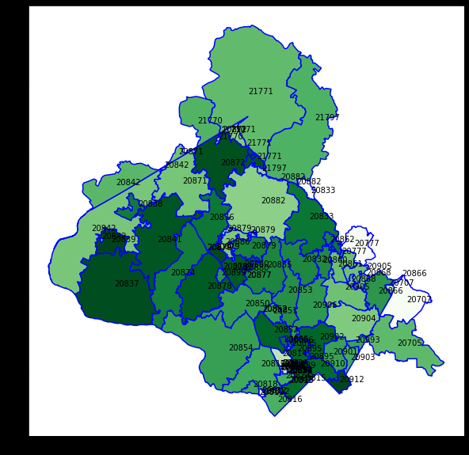
Initial MC Map for Zip Codes
Remove the regions outside MC
Have only one representative zip code for each region
Change the zip code 20993 to 20903
Need to plot a representative point for each zip code

Slide 5
MC Zip Map with Population
Manually removed the regions of the zip codes outside MC
Removed the nonstandard zip codes
Combined the polygons of each zip code into one multi-polygon
Plotted a MC map for zip codes with population (color scale)

Slide 6
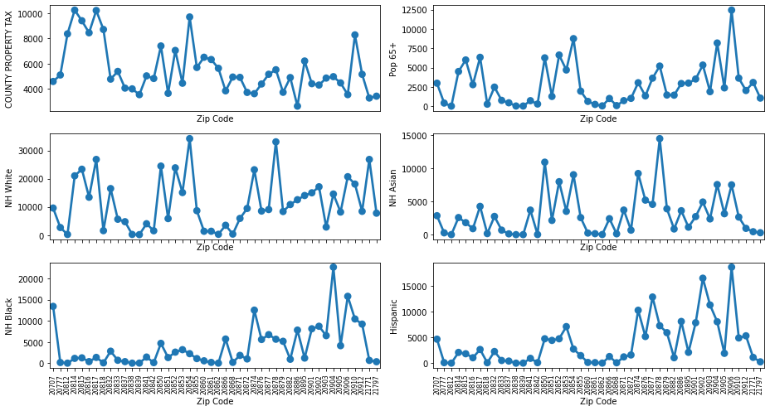
Comparing Property Tax and Race

Slide 7
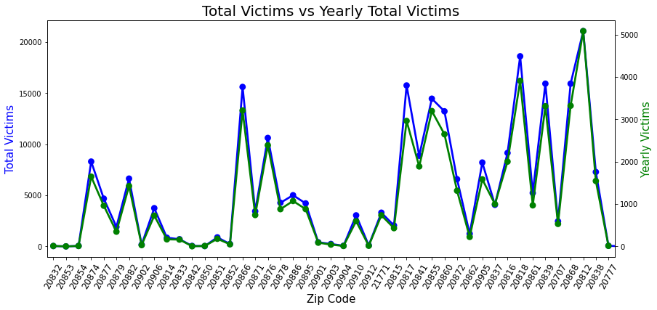
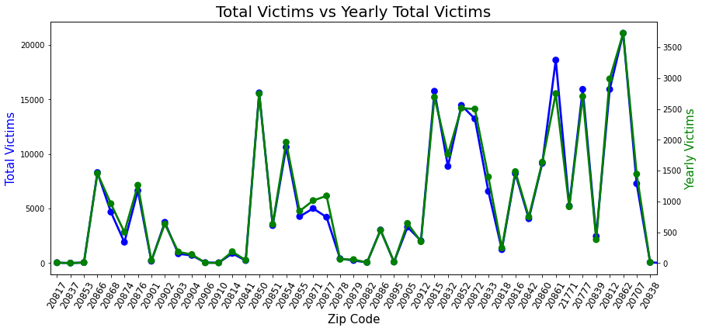

Total Victims vs Yearly Victims
First Graph: Total Victims vs Victims in 2019 with max $≈$ 5080
Second Graph: Total Victims vs Victims in 2020 with max $≈$ 3730
In 2021, the trend is almost the same with max $≈$ 1050 so far
It seems that there is an impact of the pandemic on Yearly Victims

Slide 8
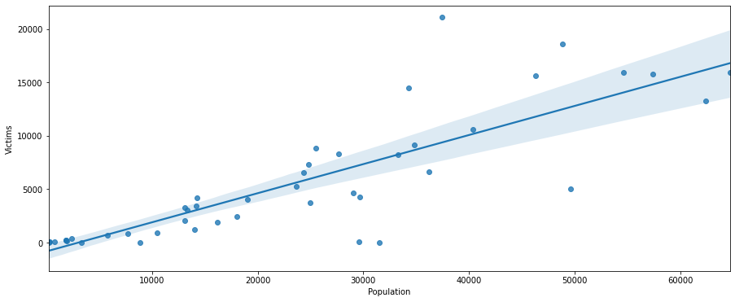

MC Population and Crime Victims
Correlation $≈$ 0.84
Population and Crime Victims are strongly and positively related
Somehow, this is an obvious observation
Need to “normalize” the number of victims

Slide 9
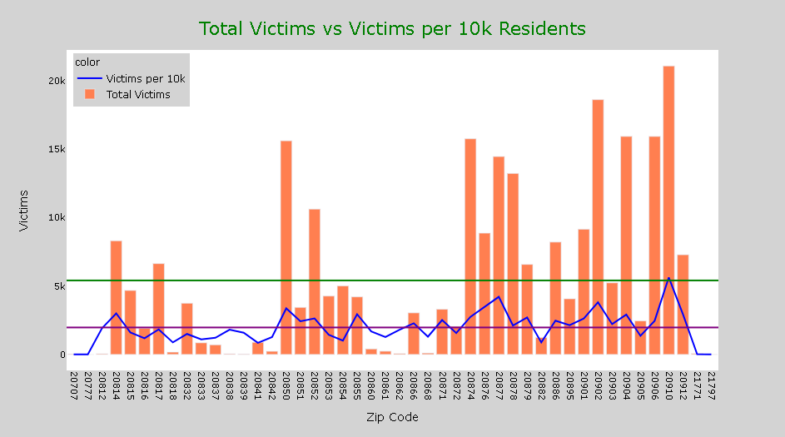
Total Victims vs Victims per 10k Residents
Bars between 20850 and 20861
Bars between 20871 and 20879
Should not be deceived by the total number of victims

Slide 10
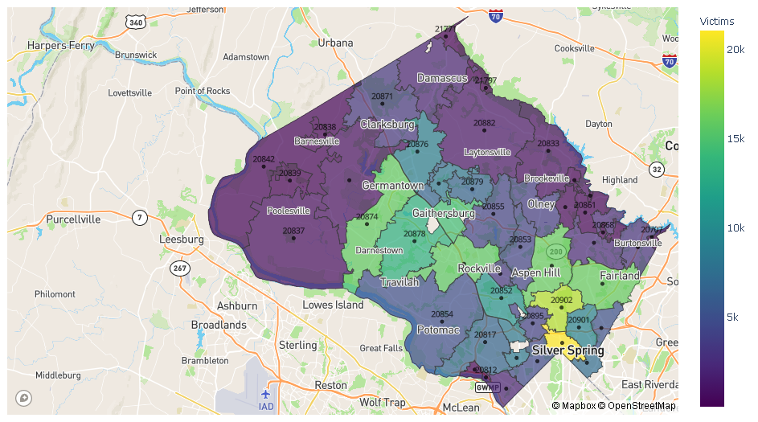
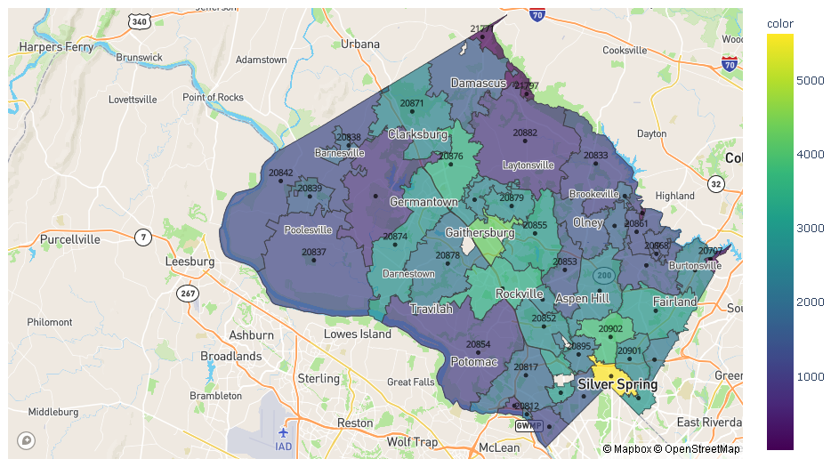
Total Victims vs Victims per 10k Residents
Total Victims
Victims per 10k Residents

Slide 11
Interactive Visualizations on MC Population and Crime Using Dash
Page 1: MC Population (2010)
Population: Population vs Population of Age 65+, Populations of NH White, NH Black, NH Asian, and Hispanic over zip codes
Zip Population: Upon clicking the region for a zip code on the left, display a pie chart about its population for race
Page 2: MC Crime (2016 ~)
Victims: Total Victims vs Victims per 10k Residents, Yearly Victims with a slide for years
Crime Names: Upon clicking the region for a zip code on the left, display a pie chart about its victims by Crime Name1 and bar graphs about its victims by Crime Name2 and 3

Slide 12
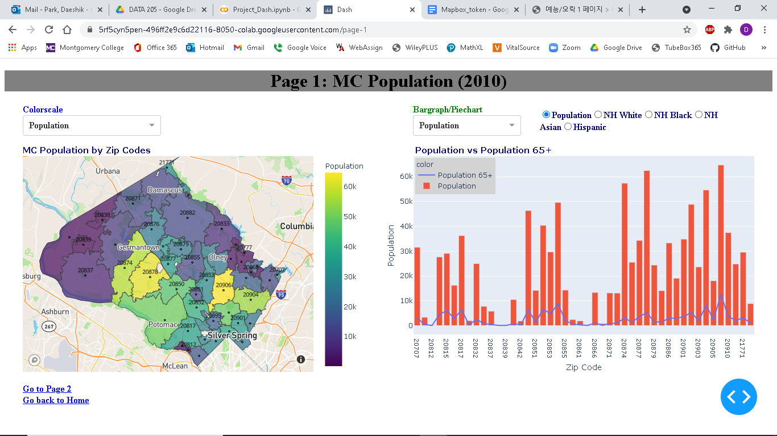
Page 1: Population Menu

Slide 13
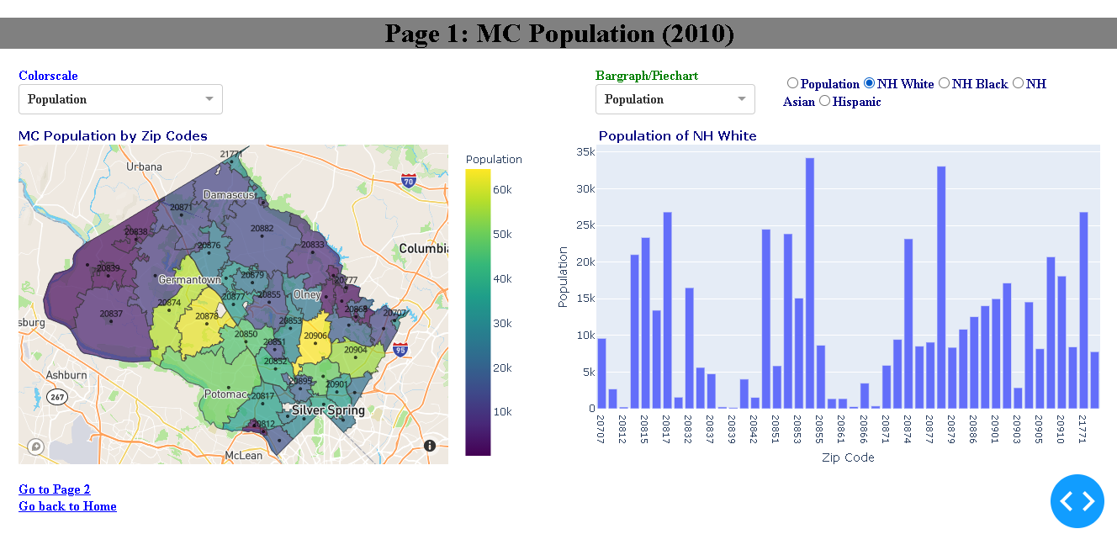
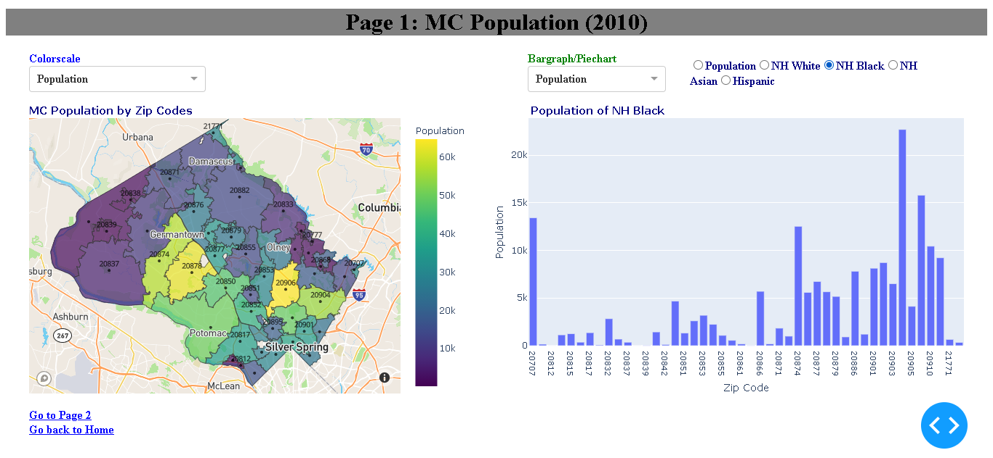
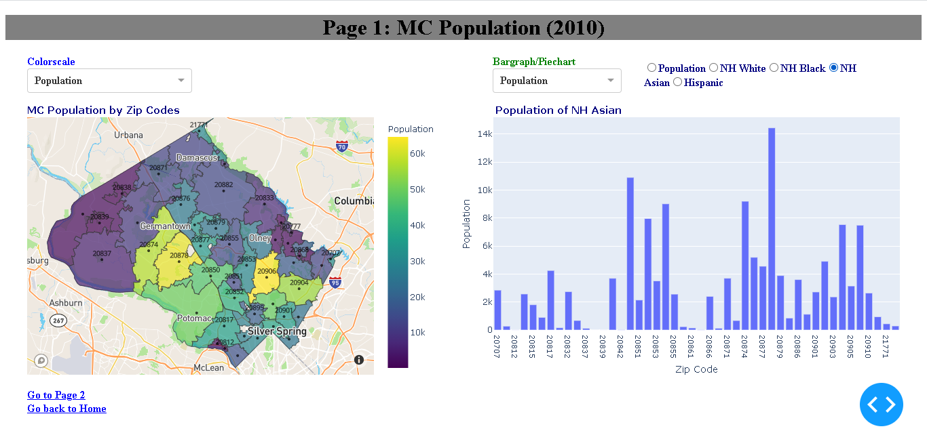
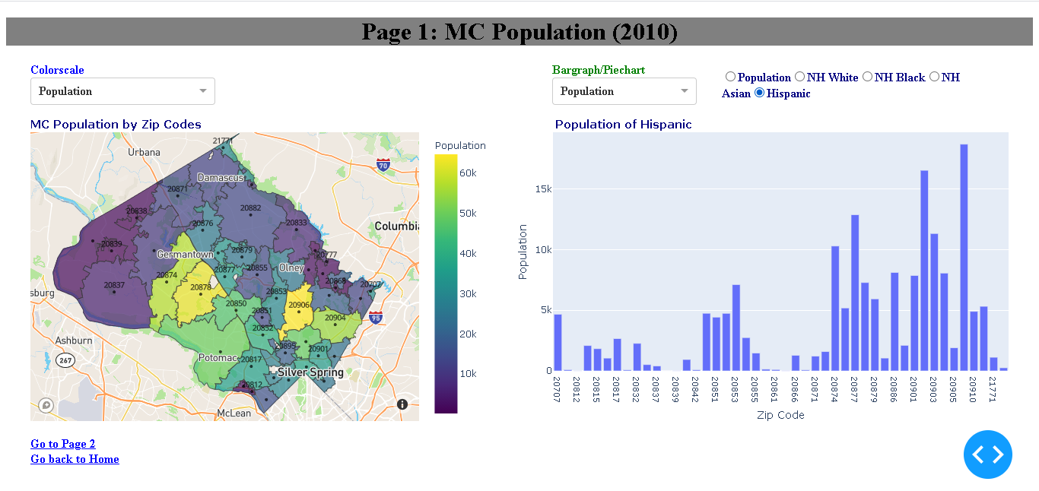
Continued

Slide 14
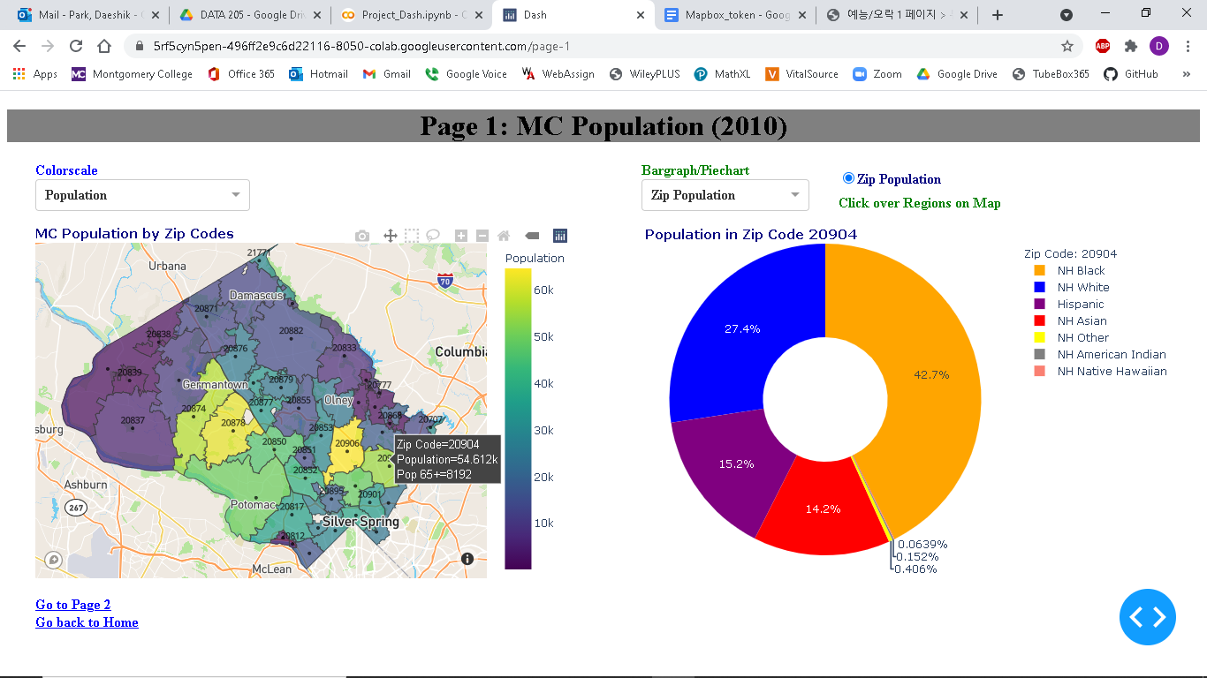
Page 1: Zip Population Menu

Slide 15
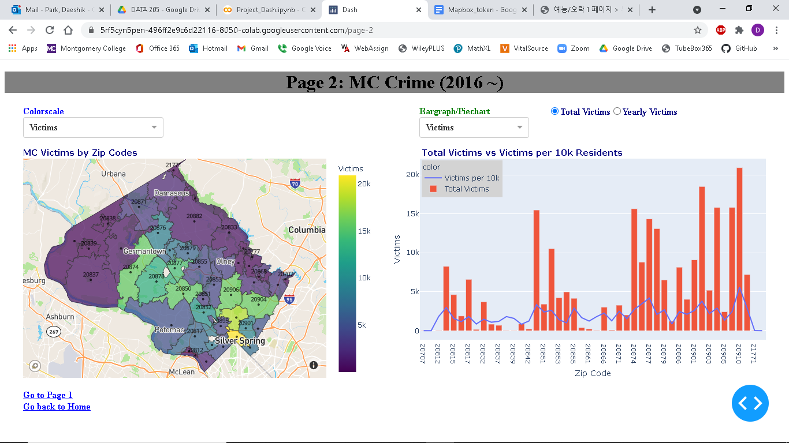
Page 2: Victims Menu

Slide 16
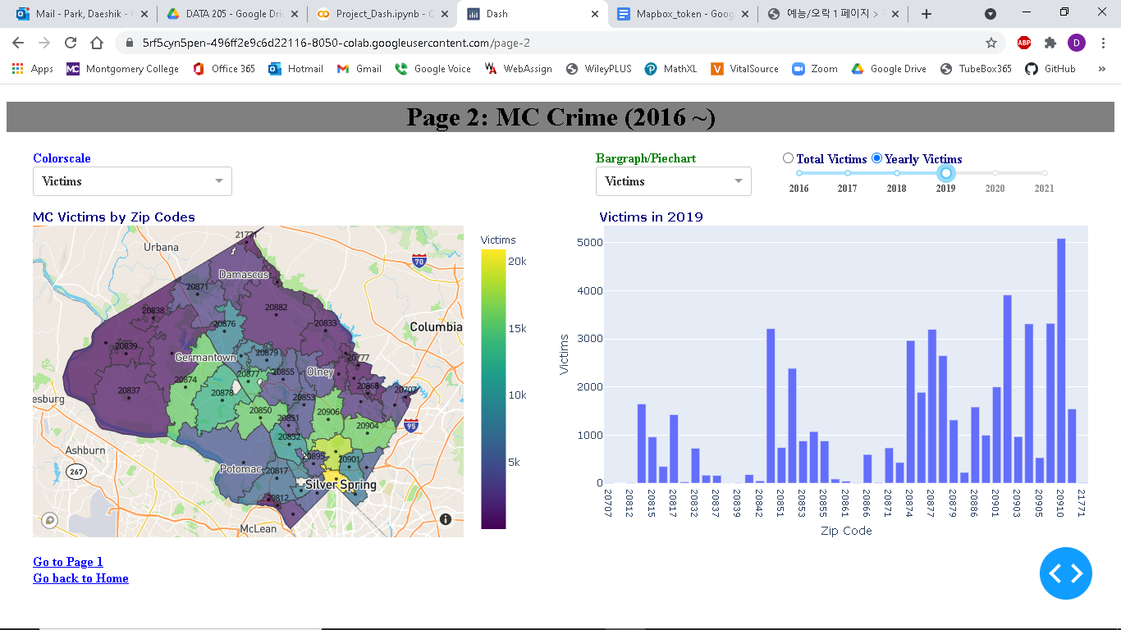

Continued

Slide 17
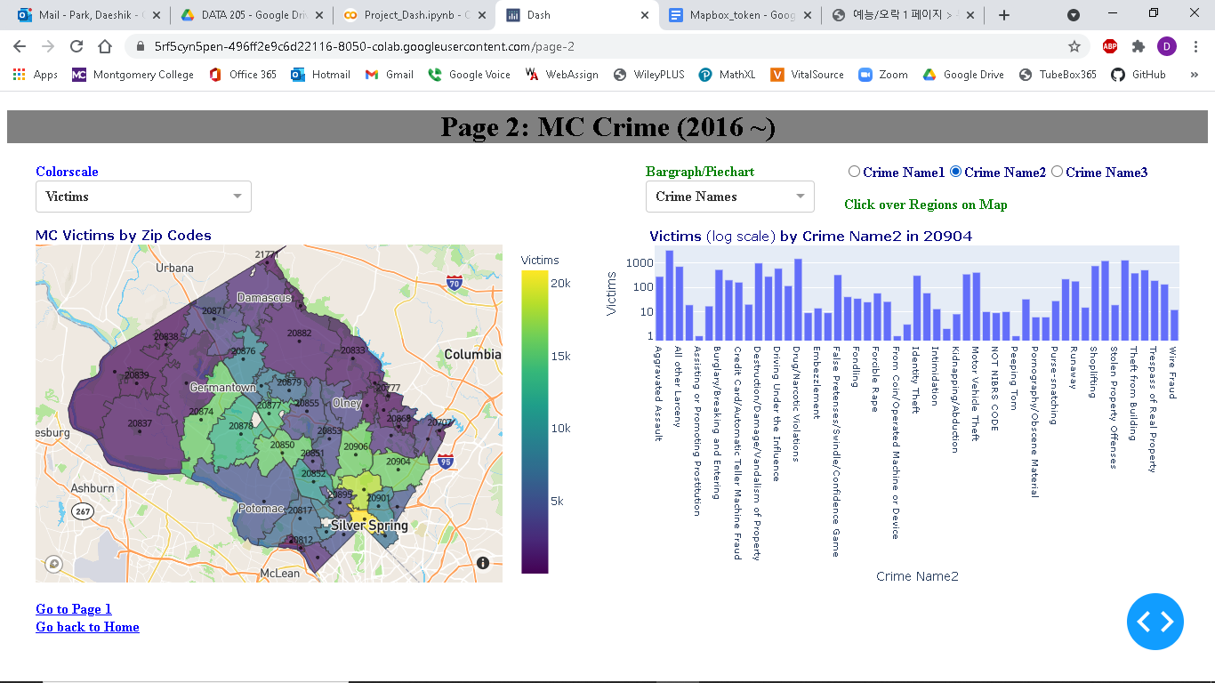
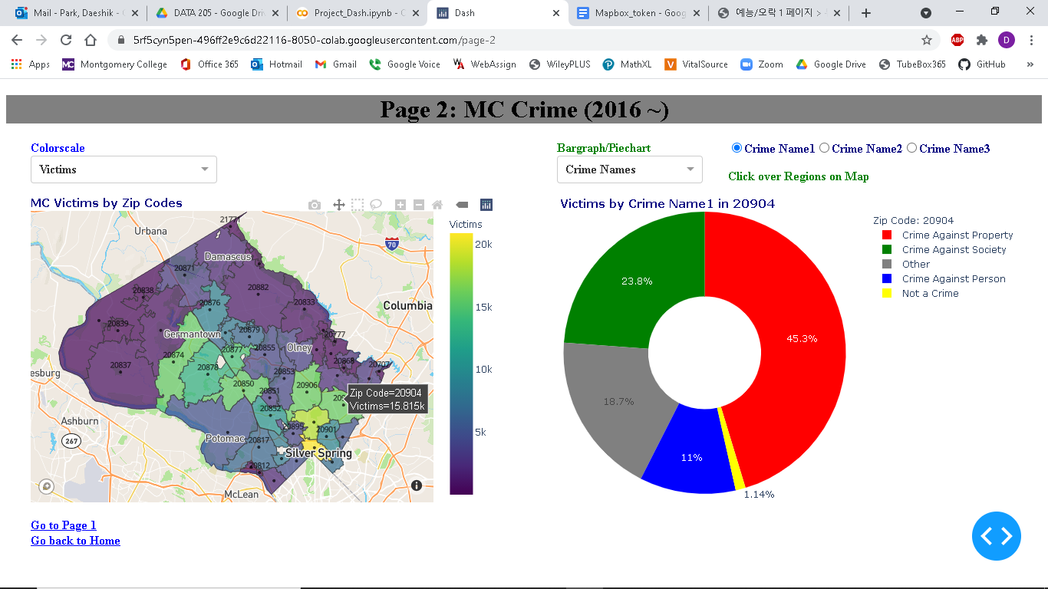
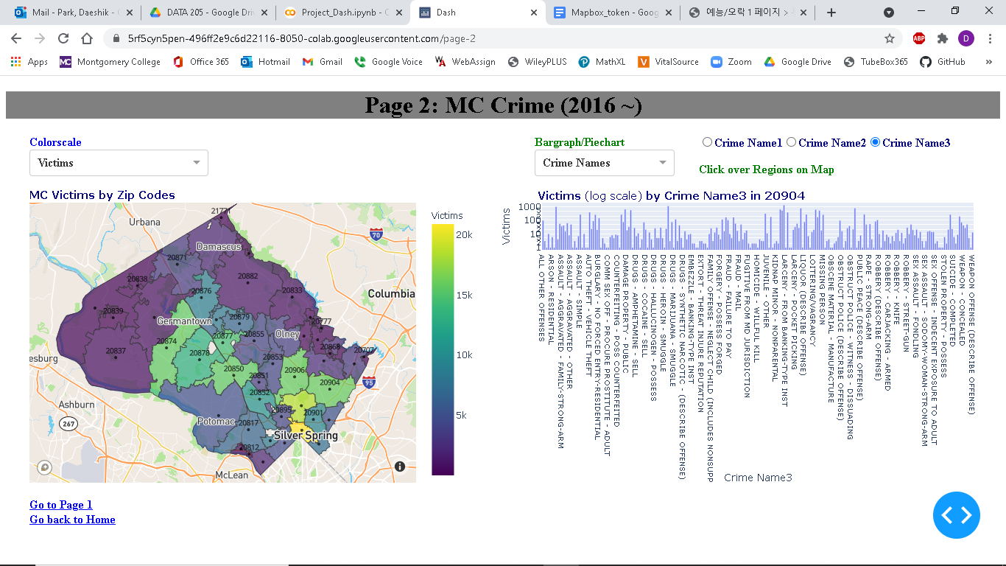
Page 2: Crime Names Menu

Slide 18
Recommendations
Suggestions
Minimize NAs
Uniform city names
Revise the shape file for zip codes to display only the regions in Montgomery County
Change the zip code 20993 to the zip code 20903 ???
Further Work
Add more filters, like cities, districts
Deploy the Dash visualizations to a web

Slide 19
Acknowledgements
Victoria Lewis - Manager of Data Montgomery Project in MC
Michael Iapalucci – Professor of DATA 205

